Slide 1
CSCI 4110 Modeling Advanced Techniques
Mark Green
Faculty of Science
UOIT

Slide 2
Introduction
Polygons and curved surfaces cover many of our modeling needs, but there are other techniques
Both of these techniques can be very laborious, each primitive is a small amount of geometry, so we need a large number of them
This can be very hard to construct by hand, we need techniques for producing large amounts of geometry without a large amount of work
There are a number of techniques that have been developed for this

Slide 3
Extrusion
Many geometrical modellers have extrusion and sweep operations that generate more complex shapes from simple shapes
An extrusion starts with a simple polygon and then moves this polygon along a 3D path constructing a mesh in the process
That is start the polygon at its original position, move it slightly along the path and then connect the old and new polygons with a mesh, like a cylinder
This is good for generating pipe-like shapes
The polygon can be scaled as it moves along the path to produce slightly more complicated shapes

Slide 4
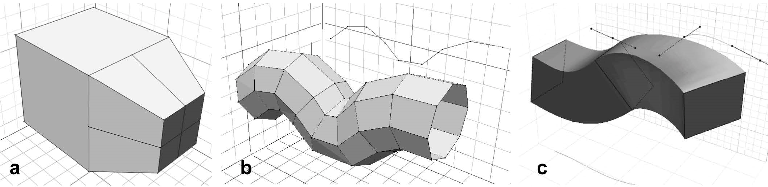
Extrusion

Slide 5
Sweep
A sweep is a rotational technique, it is based on a curve and an axis of rotation
As the curve is rotated around the axis a polygonal mesh is constructed
Both of these techniques have been used for many decades and can quickly produce interesting shapes
They are also fairly easy to implement
But, they only produce regular shapes, and not with a large number of polygons

Slide 6
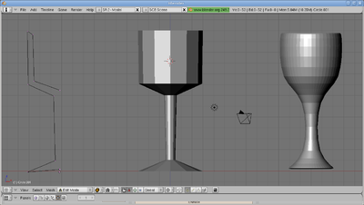
Sweep

Slide 7
Procedural Models
The basic idea behind procedure models is to use procedures (or computations) to produce the model
The idea is to start with a small number of primitives and use them to generate a very large number of primitives
This has been called database amplification by Alvy Ray Smith, you start with a small database of primitives and one or more procedures generates many more primitives

Slide 8
Procedural Models
One way of quickly building very large models with a considerable amount of detail
The primitives produced can be stored for display later, or they can be displayed dynamically as they are generated
Second approach can tune the number of primitives to object size on screen, or as the object is scaled – dynamically generate the number of primitives that are required at the moment
Similar to the subdivision techniques used to draw curves and surfaces

Slide 9

Subdivision Surfaces
Pixar’s Geri: One of the first commercial uses of subdivision surfaces

Slide 10
Subdivision Surfaces
Subdivision surfaces are a powerful modeling tool that is used extensively in the animation and special effects industry
They are found in many high end modeling programs
They first appeared in 1978 in a paper by Catmull and Clark and this is still a very active research area
Required knowledge for research in the geometrical modeling area

Slide 11
Subdivision Surfaces
The basic idea comes from the subdivision algorithms used for curve and surface display
For Bezier curves we had a technique that split one curve piece into two pieces, or a surface patch into four surface patches
In that case we were careful to generate points on the curve or surface, but now we will relax that restriction
We start with a polygonal mesh and apply a subdivision scheme to produce a refined mesh
The next slide shows two steps of this process

Slide 12
Subdivision Surfaces

Slide 13
Subdivision Surfaces
In this case we started with a triangular mesh, each refinement step replaces a triangle with 4 sub triangles
We apply this process until we get a fine enough grid
This could be a uniform subdivision over the entire object, or different parts of the object can be refined to different levels
This can be useful in display and editing

Slide 14
Subdivision Surfaces
This is a very large topic, we could devote a whole course to it! We will only look at the basics
Considerable mathematical background, used for continuity and generalized algorithms, we will not look at this in any detail
Concentrate on a few of the basic schemes and terminology used in the field
The tools that you need to read the literature, sometimes difficult to find summarized on one place

Slide 15
Subdivision Surfaces
Subdivision schemes are divided into two broad classes:
Interpolating: the original points on the surface are preserved, produce a finer grid the matches the original data
Approximating: the original points can move as the surface is refined, for example refining the convex hull of a Bezier surface
In computer graphics we are mainly interesting in approximating schemes, as long as it looks good we are happy

Slide 16
Subdivision Surfaces
A subdivision scheme can be divided into two parts:
topology: the insertion of new points into the mesh
Geometry: computing the position of the new points, and possibly the old points
These two parts are largely independent, but are quite often packaged together under the same name, which can be confusing
The most basic topological technique is Catmull-Clark, which is shown on the next slide

Slide 17
Subdivision Surfaces
Catmull-Clark or Quad subdivision

Slide 18
Subdivision Surfaces
In this scheme each quad is divided into four sub quads, new points:
One point in the middle of the quad
Four points at the middle of each edge
Given an initial quad mesh, this will always result in a quad mesh
Note that each internal vertex has four edges incident on it, called the valance of the edge, these are called ordinary vertices
All other vertices are called extraordinary vertices, an example is shown on the next slide

Slide 19
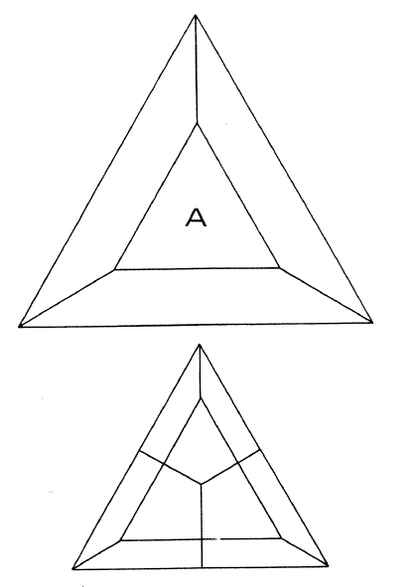
Subdivision Surfaces

Slide 20
Subdivision Surfaces
The vertex in the center has valance 3, which makes it an extraordinary vertex
This vertex will never disappear and will always be part of the mesh
Several subsequent subdivisions are shown on the next slide that show this
Why do we care?
The extraordinary vertices cause continuity problems for the surface, usually the continuity drops by one
Most of the mathematical analysis deals with this

Slide 21
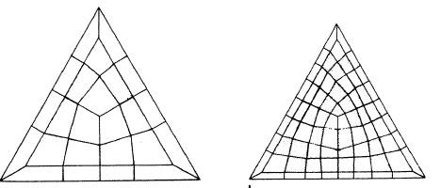
Subdivision Surfaces

Slide 22
Subdivision Surfaces
We can have a similar subdivision scheme for triangular meshes as shown on the next slide
In this case each triangle is divided into four sub triangles by inserting vertices at the mid points of each edge
Each vertex has 6 incident edges, so its ordinary vertices have a valance of 6, all other vertices are extraordinary
This is called the Loop subdivision scheme

Slide 23
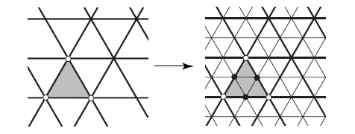
Subdivision Surfaces
Loop subdivision scheme

Slide 24
Subdivision Surfaces
Next we will look at the geometric side of one of the subdivision schemes
We will look at the Catmull-Clark scheme, for this scheme we have 5 new vertices and 4 old vertices for each quad
For the new vertex at the center of the quad, set its position to the centroid of the original four points for the quad, this is the average of the coordinates of the four vertices
This is called a face point

Slide 25
Subdivision Surfaces
Next we compute the positions of the four new edge vertices, there are two components to this:
The average of the original vertices at the ends of the edge
The average of the two face points on either side of the edge
These two averages are then averaged together

Slide 26
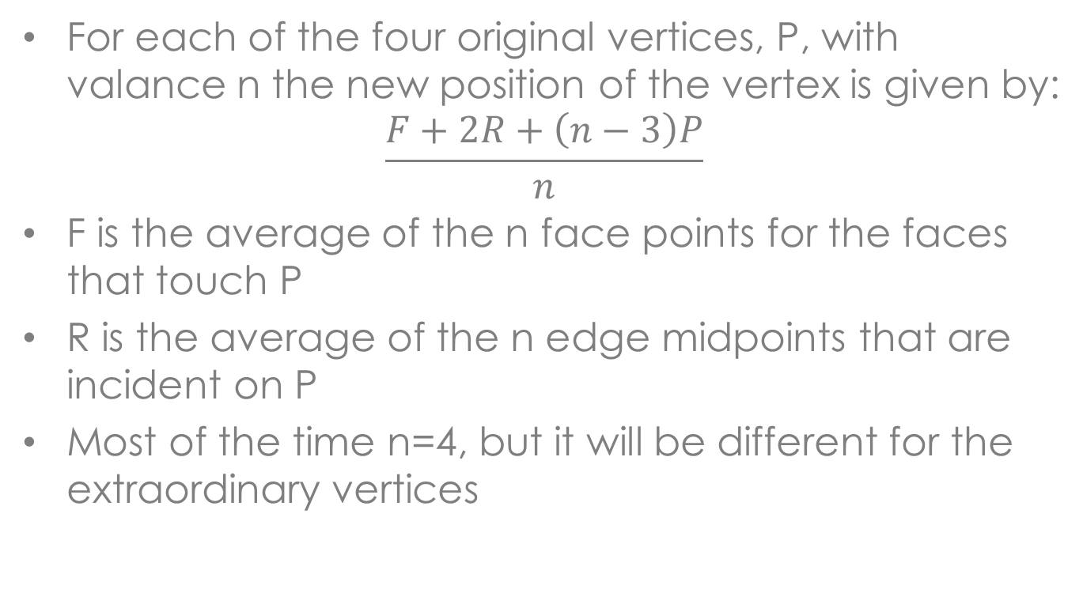
Subdivision Surfaces
For each of the four original vertices, P, with valance n the new position of the vertex is given by:
$$\frac{F+2R+\left(n−3\right)P}{n}$$
F is the average of the n face points for the faces that touch P
R is the average of the n edge midpoints that are incident on P
Most of the time n=4, but it will be different for the extraordinary vertices

Slide 27
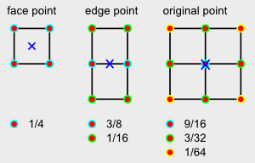
Subdivision Surfaces

Slide 28
Subdivision Surfaces
These expressions can be used to construct a matrix, S, that transforms the original vertices into the vertices for the 4 new quads
This matrix is used in the theoretical analysis of the surface
The Catmull-Clark subdivision surface is C² continuous everywhere except at the extraordinary points where it is C¹
It is an approximation scheme that basically constructs a B-spline surface

Slide 29
Subdivision Surfaces
For implementation a edge based data structure is the natural choice, since we need to find the neighbours of vertices
Some implementations use indexed face sets, but they need an extra hash table to track the new edge vertices as they are constructed
There are some more sophisticated data structures, but we won’t look at them

Slide 30
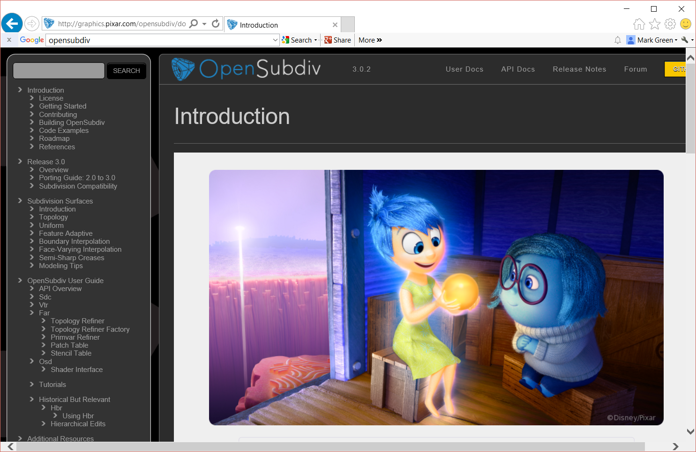
Subdivision Surfaces
Pixar has produced an open source library for subdivision surfaces: http://graphics.pixar.com/opensubdiv/docs/intro.html
This is a fairly complex package and take some time to build

Slide 31
Fractals
Fractals are a broad class of techniques that are based on the notion of self similarity
An object is self similar if it appears the same as we scale it up or down, as the object is magnified the pattern repeats at a smaller scale
Exact self similarity only appears in mathematical objects, such as the Koch or Hilbert curves
This doesn’t produce very interesting objects, so we need to relax the definition of self similarity to include some randomness

Slide 32
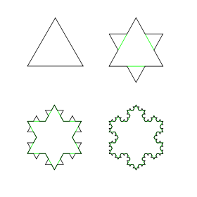
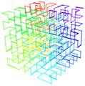
Fractals
Koch Snowflake
3D Hilbert Curve

Slide 33
Fractals
An object is statistically self similar if its statistical properties are stationary as the object scales
Typically the statistical properties scale as the object scales
One of the statistical processes with this property is fractional Brownian motion or fBm
This is a process that scales by h^{-H} as the process is scaled by h
H is the fractal dimension and varies from 0 to 1

Slide 34
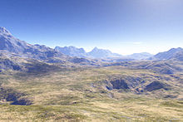
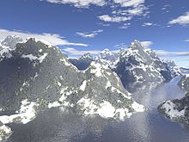
Fractals

Slide 35
Fractals
This is a big topic, we will just look at some of the basic algorithms to give a taste for how it works
One of the simplest algorithms is based on subdivision and is due to Fournier, Fussell and Carpenter in 1980, this was the first practical fractal algorithm in computer graphics
We start with a line, and compute its mid point, this line is then displaced by a random amount
This is the first level of the fractal construction process, see the next slide

Slide 36
Fractals
Random displacement

Slide 37
Fractals
We then apply this process recursively to the two line segments until we get enough points
This next slide shows some examples of the lines that can be constructed in this way
This is the basic outline, now we need to fill in the details
What random process do we use?
We are going to use a Gaussian process that is scaled with the subdivision of the curve, more specifically we will base the process on N(0,1)

Slide 38
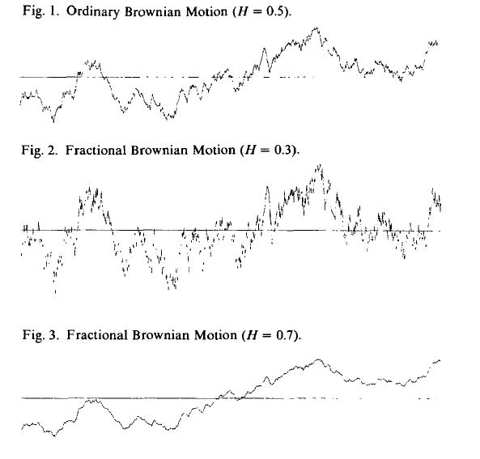
Fractals

Slide 39
Fractals
This can’t be just use any random process, it must satisfy two important properties:
The process must be fractal, it must be statistically self similar
For a given point in space we must always get the same random number
The first property we can satisfy by scaling the standard deviation by 2^{-H} on each level of subdivision, where H is the fractal dimension of the process

Slide 40
Fractals
Why do we need the second property?
We want to be able to display a fractal at any scale, that is zoom into it
This requires regenerating the fractal at a higher resolution, when we do this we want the existing points on the fractal to stay the same, they shouldn’t move
We only want to add extra points, so for the original points we need to get the same random number
This will also make it easier to do surfaces later

Slide 41
Fractals
Our random number generator needs to be a function of the point we are displacing, deterministic random numbers??
There is a way to do this (in fact there are several)
We start by constructing a large table of N(0,1) random numbers, the table size is usually a prime number
We then hash into this table to get our random number
Example: construct a hash function from point’s coordinates to give table index

Slide 42
Fractals
Using the point’s coordinate isn’t always a good idea
If we transform the fractal, the coordinates will change and we will get a different set of random numbers
One standard solution is to use parameter space, which doesn’t change on transformation
That is, for a surface we use the (u,v) coordinates of the point not its geometrical coordinates

Slide 43
Fractals
The next thing is how do we compute the displacement?
For a 2D approximately horizontal line the displacement can be in the y direction
If the line is vertical this won’t work, we won’t see the displacements
Instead we displace in the normal direction
Both approaches are used depending upon the object we are modeling

Slide 44
Fractals
We now have fractal lines, which are a useful modeling primitive
They can be used to model coast lines, see the next slide
They can also be used to model the path of rivers or sometimes highways through hilly regions
This can also be used to model lightening, in this case we can transform parameter space with time to get the motion of the lightening bolt

Slide 45
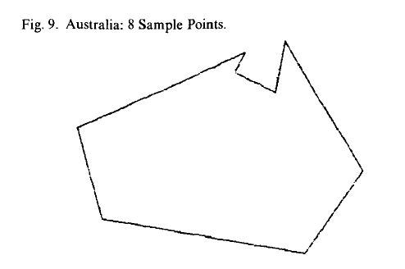
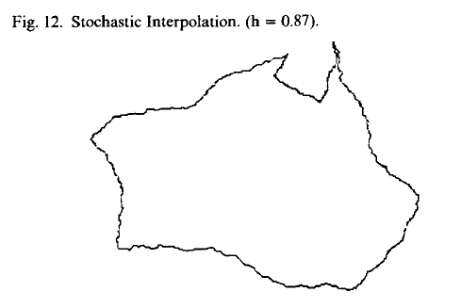
Fractals

Slide 46
Fractals
The same scheme can be used with surfaces, anything that we can subdivide
For a triangle we compute the midpoints of its three sides, displace the midpoints and then construct 4 new triangles
For quads we compute the midpoints of the four sides and displace them, we then connect opposing new points with a line, and displace their midpoints, finally we average the two midpoints to get the point in the center of the quad

Slide 47
Fractals
With meshes we need to be careful, since an edge will belong to two polygons
If we use an edge based data structure there are no problems since the edge will be subdivided once at each level
With polygon soup or indexed face sets the edge will be subdivided twice, once for each side of the edge
We want the same point both times, otherwise the mesh will start coming apart!

Slide 48
Fractals
Hashing for the random number guarantees that both sides will get the same random number, but what about the displacement direction?
If we displace in the normal direction the two sides will have different normal directions giving two different displacements
Solution: store normals with the vertices, normal for the midpoint is average of normals at the two end points

Slide 49
Fractals
Algorithm is stated recursively, but it is usually not implemented that way, too expensive in space and time
An iterative algorithm is used instead, all the subdivisions at one level are done at the same time, and then go on to the next level
There are a large number of variations on this basic approach
In the 1980s there was a lot of controversy, but this has largely mellowed out

Slide 50
Terrain
Fractals are used extensively in terrain modeling, so we will look at this separately
Terrain has some interesting properties that impact how its modelled
We could use a polygon mesh, but this is not the most efficient approach
Terrain is usually viewed as flat, at least in parameter space, so we can view it as a 2D grid with a height value at each grid point
We only need to store the height value, called a height field

Slide 51
Terrain
For small terrain samples can be viewed as flat, grid points are evenly spaced, so can easily compute (x,y) coordinates of point, read z from height field
For larger terrains use polar coordinates, grid points are at constant latitude and longitude increments
Assume constant radius, can compute point on sphere and height field value displaces in normal direction
Terrain data is very important in many applications, flight simulators, military planning, navigation, city planning, etc.

Slide 52
Terrain
There are many sources of accurate terrain data for most places on earth and parts of other planets
We can use fractals to construct virtual terrain
Start with a rough height field and then use fractals to fill in the details
Minimum: values at 4 corners of the height field, but could have more values
This can be used to give more control over the terrain that is constructed

Slide 53
Terrain
One approach is to use two passes over the height field for each level of the fractal
On the first pass we compute the center of each of the existing quads, the average of the four corners, plus the random displacement
In the second pass the points computed in the first pass are used to compute the edge points, again average four first pass points and add a random displacement
This has been called the diamond-square algorithm and is shown on the next slide

Slide 54
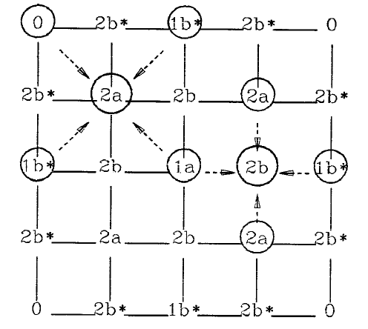
Terrain

Slide 55
Terrain
There are other approaches to doing terrain, this is still an active research area
Musgrave describes a different approach in the book Texturing and Modeling: A Procedural Approach, which is based on a different algorithm for computing the random perturbation
This approach uses Perlin’s noise and computes the displacement directly at each point instead of using a recursive or iterative algorithm

Slide 56
L-Systems
Used to model plants, trees and other botanical objects (see next slide)
Named after Lindenmayer who developed the original mathematics
Alvy Ray Smith was probably the first person to use them for computer graphics, 1984
The standard technique that is used to model plants in computer graphics, number of software packages that use it

Slide 57
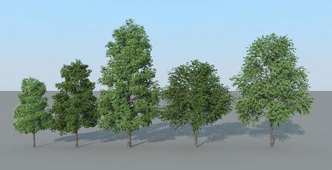
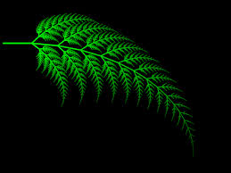
L-Systems

Slide 58
L-Systems
In graphics an L-system consists of two parts:
A special type of grammar
An interpretation of the strings in the grammar
In practice the two parts are usually combined
The grammar consists of one or more productions and an initiator, which is the original string
Unlike normal grammars the productions are applied in parallel
In each step all of the symbols are replaced

Slide 59
L-Systems
One of the common interpretations that is used is turtle graphics
Imagine a pen attached the tail of a turtle, it draws as the turtle moves
The symbol F is interpreted as moving forward, + as turn left and – as turn right
This is enough to get us started, there are many other commands
We can now turn to a simple example

Slide 60
Example

Slide 61
L-Systems
Unlike normal grammars L-systems tend to run forever, they don’t terminate
Thus we need to stop them after a fixed number of generations
The next two slides show how a simple branching pattern can be produced
The [ and ] symbols are used to push and pop the turtle state on a stack
Turtle can return to a branch point and continue with the next branch

Slide 62
L-Systems

Slide 63
L-Systems

Slide 64
L-Systems
To move to 3D we need to add 4 more turtle commands that produce rotations about the other two axis
An example of this is on the next slide
Usually the branches are converted into tapered cylinders and then texture mapped with bark
Leaves can either be generated by the L-system or added later using a standard modeller

Slide 65
L-Systems

Slide 66
L-Systems

Slide 67
L-Systems
Reference:
Przemyslaw Prusinkiewicz, Aristid LindenMayer, The Algorithmic Beauty of Plants, Springer-Verlag, 1990
This is available as a free download online from Prusinkiewicz’s web site at the University of Calgary

Slide 68
Particle Systems
Particle systems can be viewed as both a modeling and an animation technique
Show the power of using many simple objects to model complex objects
Proposed by Bill Reeves in 1983, used to model fire and similar phenomena
Based on simple particles, have no real shape, a pixel in size
Simple ballistic motion, rendering typically contributes to a pixel, or the path can be drawn

Slide 69
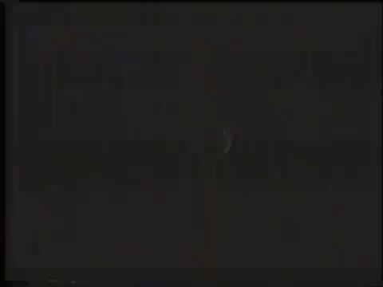
The Beginning

Slide 70
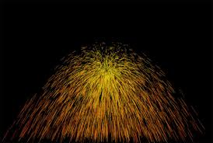
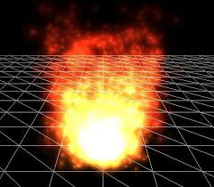
Particle Systems

Slide 71
Particle Systems
A particle starts with an initial position p and velocity v, at each time step we compute:
p = p + Δt * v
v = v + Δt * a
Where Δt is the length of the time step and a is usually the acceleration of gravity
A particle may be assigned a random lifetime when its created, or can be terminated when it reaches a particular level, example ground level
Particles typically have a number of randomly generated properties

Slide 72
Particle Systems
The power of particle systems is in their numbers, usually thousands
The particles are usually generated from a source, a simple shape in 3D space, circle, square, rectangle, etc.
The initial positions are randomly distributed over the source
The initial velocity is also random, usually a mean velocity and some sort of variance is specified

Slide 73
Particle Systems
General algorithm:
Move existing particles
Remove dead particles
Generate new particles
Draw particles
There is one problem with this algorithm, if all the particles are generated at the same time point they will bunch together
Solution: generated random birth time, move particle by this amount

Slide 74
Particle Systems
How the particle is drawn depends upon what we are simulating
In the case of fire, each particle adds colour to the pixel it covers, particle colour is reduced over time
For grass, each particle is a blade of grass, draw the complete particle path once the system is complete
Fireworks can be done in a similar way, can draw the path as the particle moves

Slide 75
Particle Systems
Note: there is a lot of parallelism here, makes it ideal for a GPU implementation
Produces a very efficient effect, included in many game engines
Considerable amount of information on the web, can find open source implementations
Usually some custom programming is required to get special effects

Slide 76
Other Approaches
There are a number of interesting techniques that we don’t have time to look at
There are a number of techniques that are based on implicit surfaces, they give very interesting blobby shapes
Point based modeling is a new technique using points as the basic modeling primitive
As polygonal models get larger the average size of a polygon is approaching a pixel, they have essentially become points, so model directly with points

Slide 77
Summary
First examine two different modeling techniques, both based on subdivision
One gives us smoother shapes, while the other gives us rougher shapes
Both amplify our database by producing many more primitives from a simple seed
Then examined L-Systems and particle systems, both of these techniques are used for a particular type of object

